Slide 1
EF-EP-004-MCB
EPIC:
Products Selection (Dealer & Vehicle)

Slide 2
EF-EP-004: Products Selection (Dealer & Vehicle)
Story ID: ES-S 001:
As a user I want to select the vehicle so that I can start the finance application process
Story ID: ES-S 002:
As a user I want to have the information of the vehicle displayed (pictures, options,...) so that I can see which car I want to purchase / finance.
Story ID: ES-S 003:
XXX
Story ID: ES-S 004:
As a user I want to chose the dealership of the car I would like to purchase / finance so that I can continue the process later on in my next visit and so that I can get the dealer specific vehicle / finance product.
Story ID: ES-S 005:
As a user I want to adjust the MSRP to the agreed quotation price so that I can finance the quotation price & so that I can get a binding offer from the dealer
Story ID: ES-S 006:
As a user I want the Dealer automatically pre-filled so that I don't have to search for the specific dealer

Slide 3
Story ID: EP-004-S 001:
OWNER: PO (BA)
Business
Legal
As a user I want to select the vehicle so that I can start the finance application process
Assumptions:
The vehicle is already chosen and no pipeline check necessary
The dealership is already selected (EPIC 4 - S 004 & S 006)
The transaction price is already negotiated offline between user and sales manager
Customer Successfully registered or used existing GCDM/BMW Account to login to BMW Easy Finance APP.
Customer Successfully Redirected himself to Product Selection page upon using User friendly App’s Navigation
Customer is physically at the dealership in the reach of F&I
Pre-Conditions:
Customer should be allowed to filter BMW Vehicle from various filter parameters.
Most up to date and correct vehicle product information is available for customer to choose.
Acceptance Criteria:
The user selected the Brand BMW / MINI.
The user selected the vehicle series by clicking / swiping. A picture of the respective series is displayed.
The user selected the vehicle model (drop down)
The user selected the vehicle package (drop down)
The MSRP of the selected vehicle series, model & package is displayed correctly
As a user I get a disclaimer displayed that this is not the actual vehicle and it might be not available, the purpose of the vehicle choosing is to start the application
Once the car is selected the user can click next and enters “transaction price confirmation price page” EPIC 4 -S 005
The user can click back button and enters landing page
IT
Security

Slide 4
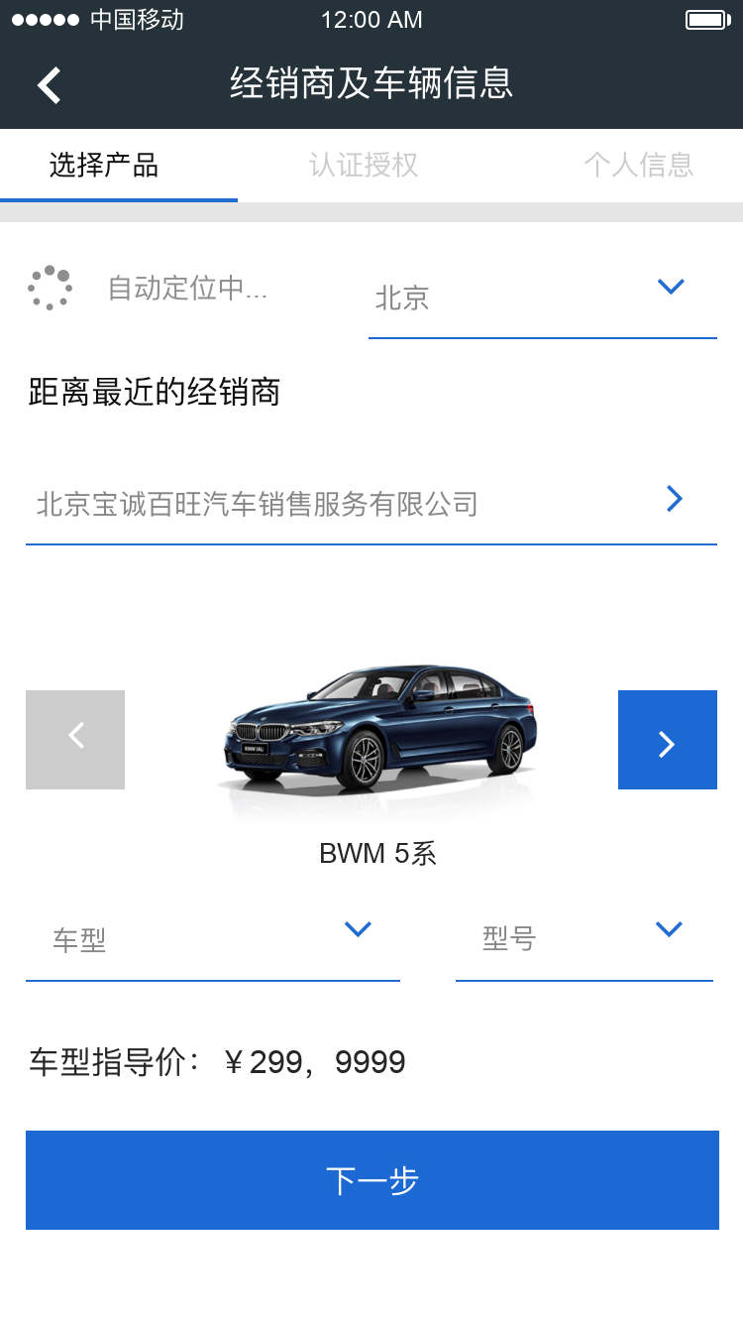
Story ID: EF-EP-004-ES-S 001 Vehicle Selection
Mockups:
Vehicle Series
Model
Package
Vehicle selection for customer should be easy, only include series, model, packages.
vehicle picture to show with series selection.
Languages in Chinese and English.
BMW and MINI CI

Slide 5
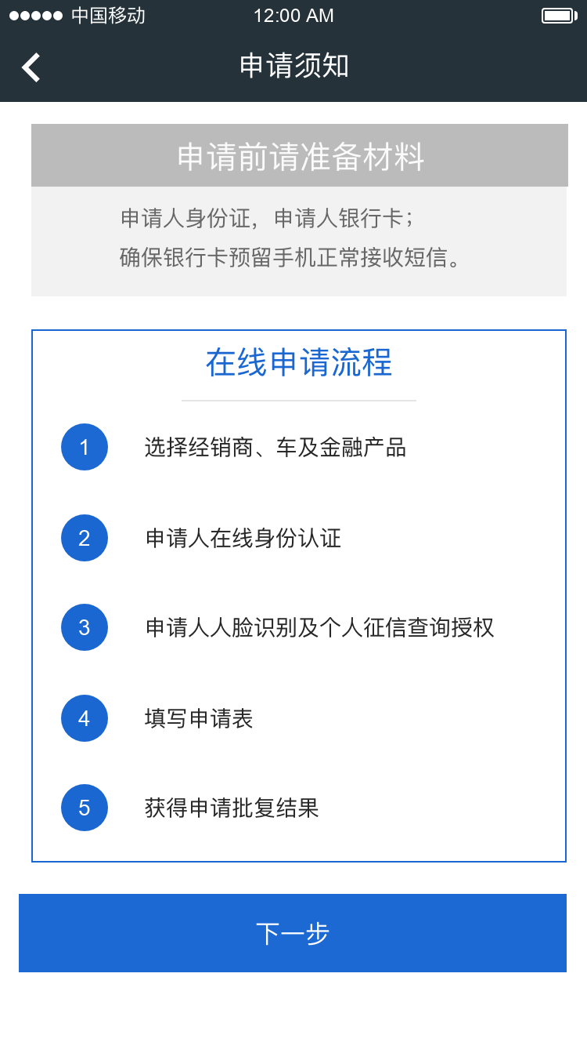
Story ID: EF-EP-004-ES-S 001 Vehicle Selection
Wireframes
Negotiated Transaction Price
$ 250, 000
Disclaimer

Slide 6
Story ID: EF-EP-004-ES-S 001 Vehicle Selection
Process Flow:
Easy Finance APP
Vehicle Selection Process
User: Main Applicant
User: Co-Borrower /Guarantor
User: F&I

Slide 7
Story ID: EF-EP-004-ES-S 001 Vehicle Selection
Sequence Flow

Slide 8
Story ID: EF-EP-004-ES-S 002: Vehicle Information and Picture
OWNER: PO (BA)
Business
Legal
As a user I want to have the information of the vehicle displayed (pictures, options,...)
so that I can see which car I want to purchase / finance.
Assumptions:
The vehicle is already chosen and no pipeline check necessary
The dealership is already selected (EPIC 4 - S 004 & S 006)
The transaction price is already negotiated offline between user and sales manager
Customer Successfully registered or used existing GCDM/BMW Account to login to BMW Easy Finance APP.
Customer Successfully Redirected himself to Product Selection page upon using User friendly App’s Navigation
Customer is physically at the dealership in the reach of F&I
Pre-Conditions:
Customer should be allowed to filter BMW Vehicle from various filter parameters.
Most up to date and correct vehicle product information is available for customer to choose.
Acceptance Criteria:
The user selected the vehicle series by clicking / swiping. A picture of the respective series is displayed.
Options of the vehicle can be selected the correct information, prices & pictures are displayed
IT
Security

Slide 9
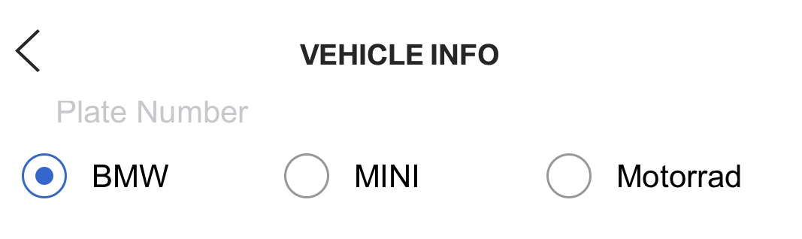
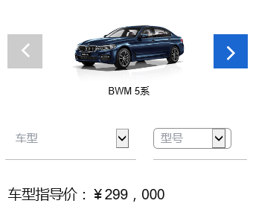
Story ID: EF-EP-004-ES-S 002 Vehicle Information and Picture
Mockups:
Picture?
Options?
ASP Products?
Model
Package

Slide 10
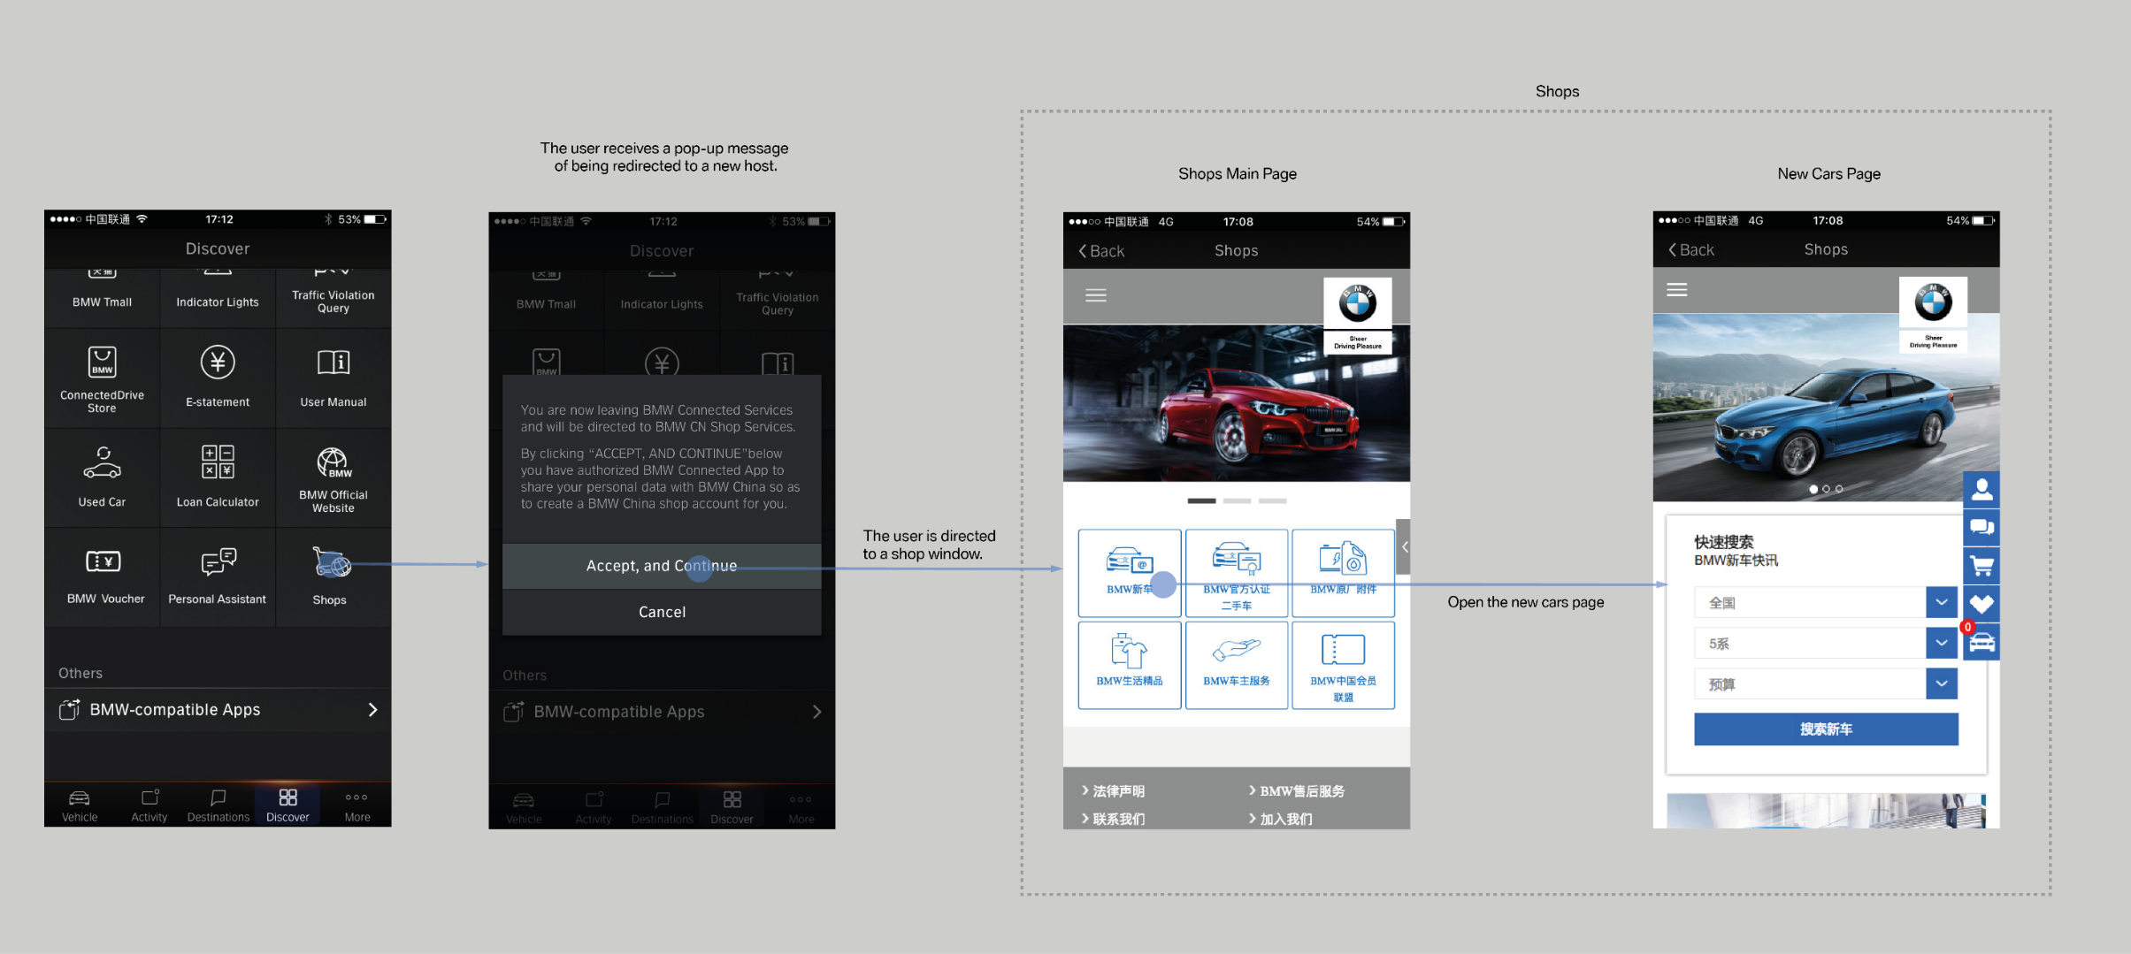
Story ID: EF-EP-004-ES-S 002 Vehicle Information and Picture
Wireframes
Sample

Slide 11
Story ID: EF-EP-004-ES-S 002 Vehicle Information and Picture
Process Flow:
Easy Finance APP
Registration
Process

Slide 12
Story ID: EF-EP-004-ES-S 002 Vehicle Information and Picture
Sequence Flow

Slide 13
Story ID: EF-EP-004-ES-S 004: Select Dealership
OWNER: PO (BA)
Business
Legal
As a user I want to chose the dealership of the car I would like to purchase / finance
so that I can continue the process later on in my next visit and so that I can get the dealer specific vehicle / finance product.
Assumptions:
The vehicle is already chosen and no pipeline check necessary
Customer Successfully registered or used existing GCDM/BMW Account to login to BMW Easy Finance APP.
Customer Successfully Redirected himself to Product Selection page upon using User friendly App’s Navigation
Customer is physically at the dealership in the reach of F&I
Pre-Conditions:
Customer should be allowed to filter BMW Dealership from various filter parameters.
Most up to date dealership information is available for customer to choose.
Acceptance Criteria:
User selected Province / City (drop down)
User selected dealer from drop down list predefined and filtered by city
Once the dealership is selected the user can continue to select the vehicle
The user can click back button and enters landing page
IT
Security

Slide 14
Story ID: EF-EP-004-ES-S 004 Select Dealership
Mockups:
Select Dealer
- Province / City
- Dealer

Slide 15
Story ID: EF-EP-004-ES-S 004 Select Dealership
Wireframes
Negotiated Transaction Price
$ 250, 000
Disclaimer

Slide 16
Story ID: EF-EP-004-ES-S 004 Select Dealership
Process Flow:
Easy Finance APP
Registration
Process

Slide 17
Story ID: EF-EP-004-ES-S 004 Select Dealership
Sequence Flow

Slide 18
Story ID: EF-EP-004-ES-S 005: Quotation Price
OWNER: PO (BA)
Business
Legal
As a user I want to adjust the MSRP to the agreed quotation price so that I can finance the quotation price
& so that I can get a binding offer from the dealer
Assumptions:
The vehicle is already chosen and no pipeline check necessary
Customer Successfully registered or used existing GCDM/BMW Account to login to BMW Easy Finance APP.
Customer Successfully Redirected himself to Product Selection page upon using User friendly App’s Navigation
Customer is physically at the dealership in the reach of F&I
Dependency with the binding offer management (DFE Review and Audit) EF-EP-005-ES-S 001, ES-S 002 & ES-S 004
Pre-Conditions:
Customer should be allowed to enter Quotation price into the free box.
The right dealership is selected by the user (EF-EP-004-ES-S 004 / ES-S 006)
The transaction price is already negotiated offline between user and sales manager
Acceptance Criteria:
User enters the transaction price into the empty box Disclaimer is shown (vehicle availability and price is to be confirmed by dealer)
In the box only a reasonable amount can be entered. Once alphabetic, icons or an unreasonable amount is input (to be defined: e.g. 0, >10% of MSRP) a pop up message should guide the user entering the right amount (including disclaimer)
User can only click submit if all criteria are met (e.g. Quotation price is entered correctly and Dealership / Vehicle is selected)
After submission of the quotation the customer cannot change the selections (dealer, vehicle & quotation) and a pop up is reminding the user the quotation is in review by the F&I.
If the customer clicks the back button, the dealer ship selection & vehicle selection is shown.
If the customer clicks submit the user will be able to select the finance product, after this selection, the F&I can review and audit the quotation
IT
Security
Risk
What happens if the quotation price is not confirmed?
F&I overwrites in DFE, confirms and the newly submitted transaction price is synchronize to the User. User cannot change the price submitted by the dealer.

Slide 19
Story ID: EF-EP-004-ES-S 005 Quotation Price
Mockups:
Negotiated Transaction Price
$ 250, 000
Disclaimer

Slide 20


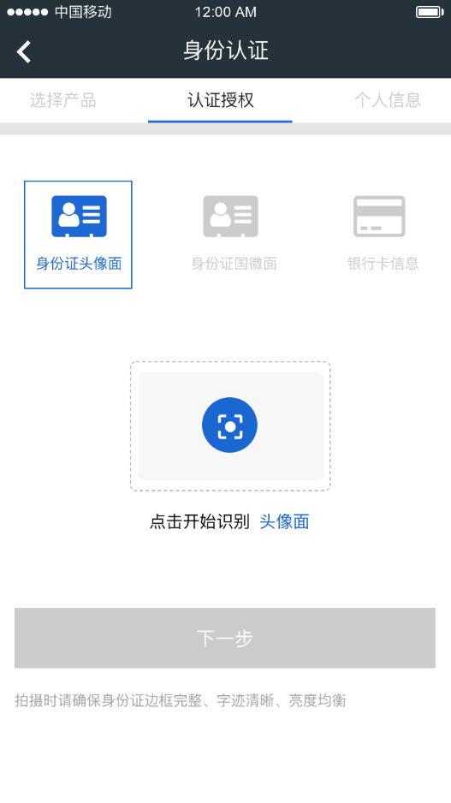

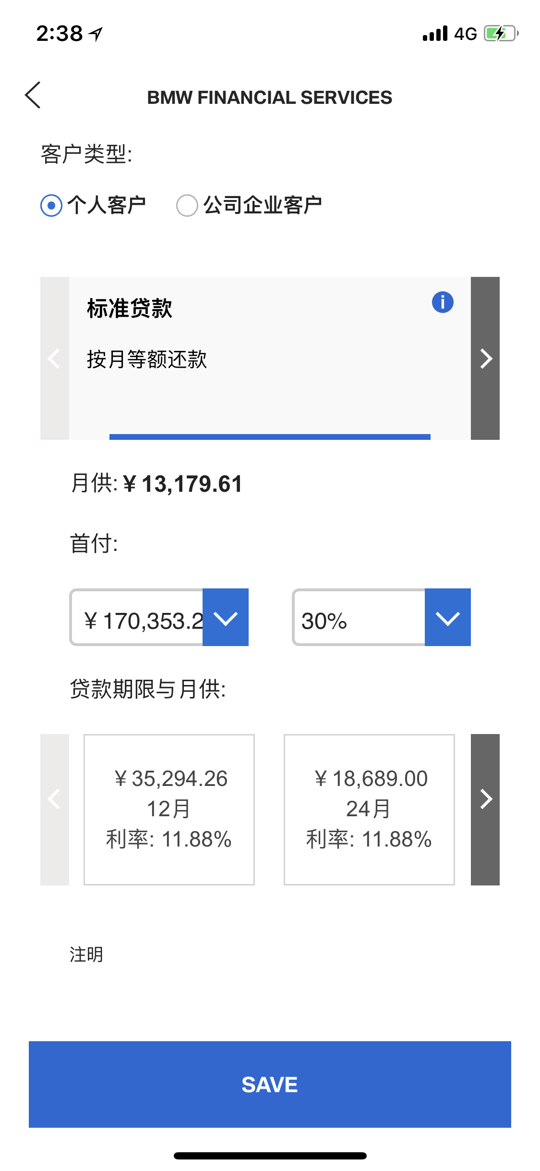
Story ID: EF-EP-004-ES-S 005 Quotation Price
Wireframes
Negotiated Transaction Price
$ 250, 000
Disclaimer

Slide 21
Story ID: EF-EP-004-ES-S 005 Quotation Price
Process Flow:
Easy Finance APP
Quotation Price Confirmation
User: Main Applicant
User: Co-Borrower /Guarantor
User: F&I

Slide 22
Story ID: EF-EP-004-ES-S 005 Quotation Price
Sequence Flow

Slide 23
Story ID: EF-EP-004-ES-S 006: LBS Dealership selection
OWNER: PO (BA)
Business
Legal
I want the Dealer automatically pre-filled so that I don't have to search for the specific dealer
Assumptions:
The vehicle is already chosen and no pipeline check necessary
Customer Successfully registered or used existing GCDM/BMW Account to login to BMW Easy Finance APP.
Customer Successfully Redirected himself to Product Selection page upon using User friendly App’s Navigation
Customer is physically at the dealership in the reach of F&I
Pre-Conditions:
Customer is physically at the dealership in the reach of F&I
User accepted location based services and GPS is usable and activated
Acceptance Criteria:
User clicks on the on the LBS icon, city and dealer are prefilled based on the GPS location
User can overwrite the prefilled information by clicking and selecting from the dropdown list
IT
Security

Slide 24
Story ID: EF-EP-004-ES-S 006 LBS Dealership selection
Mockups:
Select Dealer by location based service. Prefill of:
- Province / City
- Dealer

Slide 25
Story ID: EF-EP-004-ES-S 006 LBS Dealership selection
Wireframes
Negotiated Transaction Price
$ 250, 000
Disclaimer

Slide 26
Story ID: EF-EP-004-ES-S 006 LBS Dealership selection
Process Flow:
Easy Finance APP
Registration
Process

Slide 27
Story ID: EF-EP-004-ES-S 006 LBS Dealership selection
Sequence Flow

